Slide 1
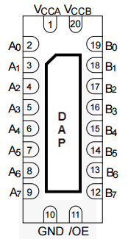
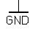
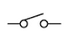
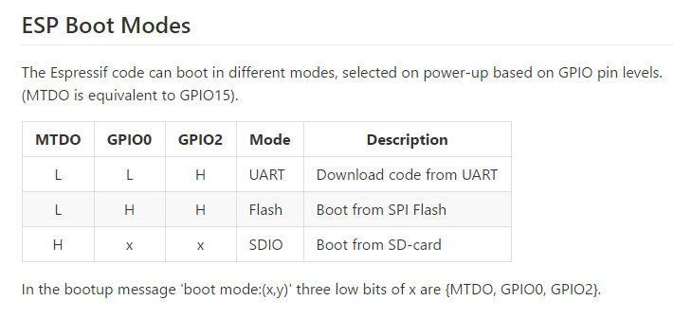
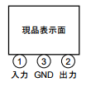
Vehicle Sensing Unit
5V
5V
5V
3V3
3V3
5V
AIR
Sensor
MCP3208
CH0
CH1
CH2
CH3
CH4
CH5
CH6
CH7
Vdd
Vref
AGND
CLK
DO
DI
CS_
DGND
ESP-WROOM-02
3V3
EN
CLK
MISO
MOSI
MTDO
IO2
IO0
GND
GND
IO16
TOUT
RST
IO5
GND
TXD
RXD
IO4
USB-COM
5V
GND
TX
RX
5V
SW
.1uF
JP
3V3
Boot from SPI Flash
Download code from UART
.1uF
5V
TA48M033F
3V3
2
1
3
+
.1uF
33uF

Slide 2
Board Wiring Layout
5V
AIR
Sensor
MCP3208
ESP-WROOM-02
CH0
CH1
CH2
CH3
CH4
CH5
CH6
CH7
Vdd
Vref
AGND
CLK
DO
DI
CS_
DGND
3V3
EN
CLK
MISO
MOSI
MTDO
IO2
IO0
GND
GND
IO16
TOUT
RST
IO5
GND
TXD
RXD
IO4
SW
.1uF
3
2
TA48M033F
1
.1uF
33uF
+
5V
GND
TX
RX
USB-COM
JP

Slide 3
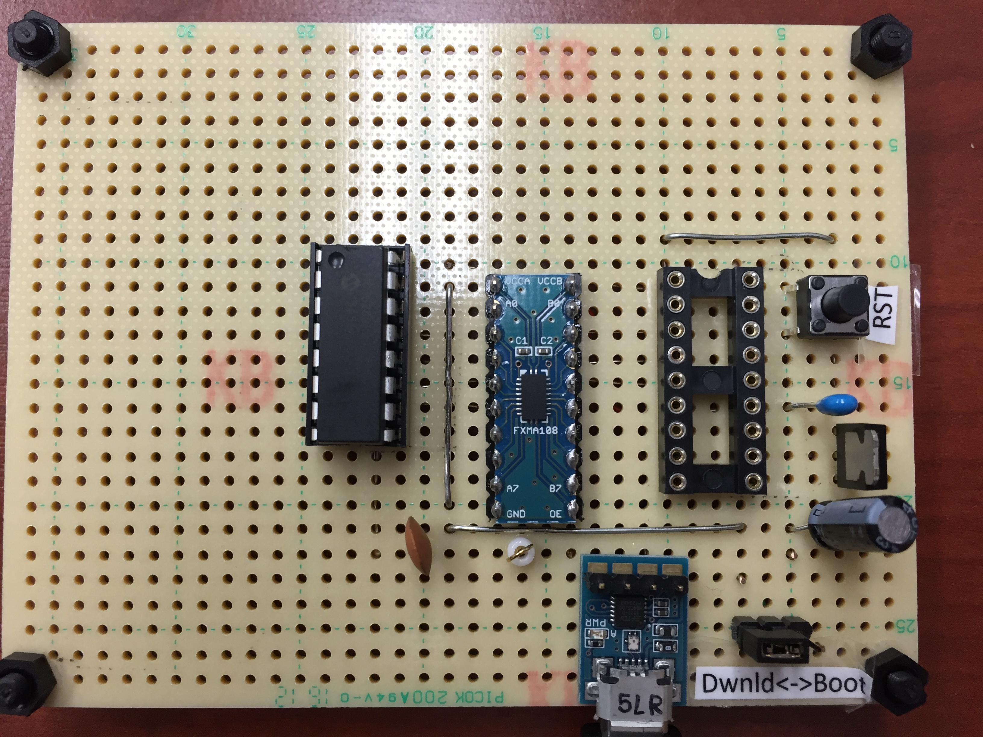

Slide 4
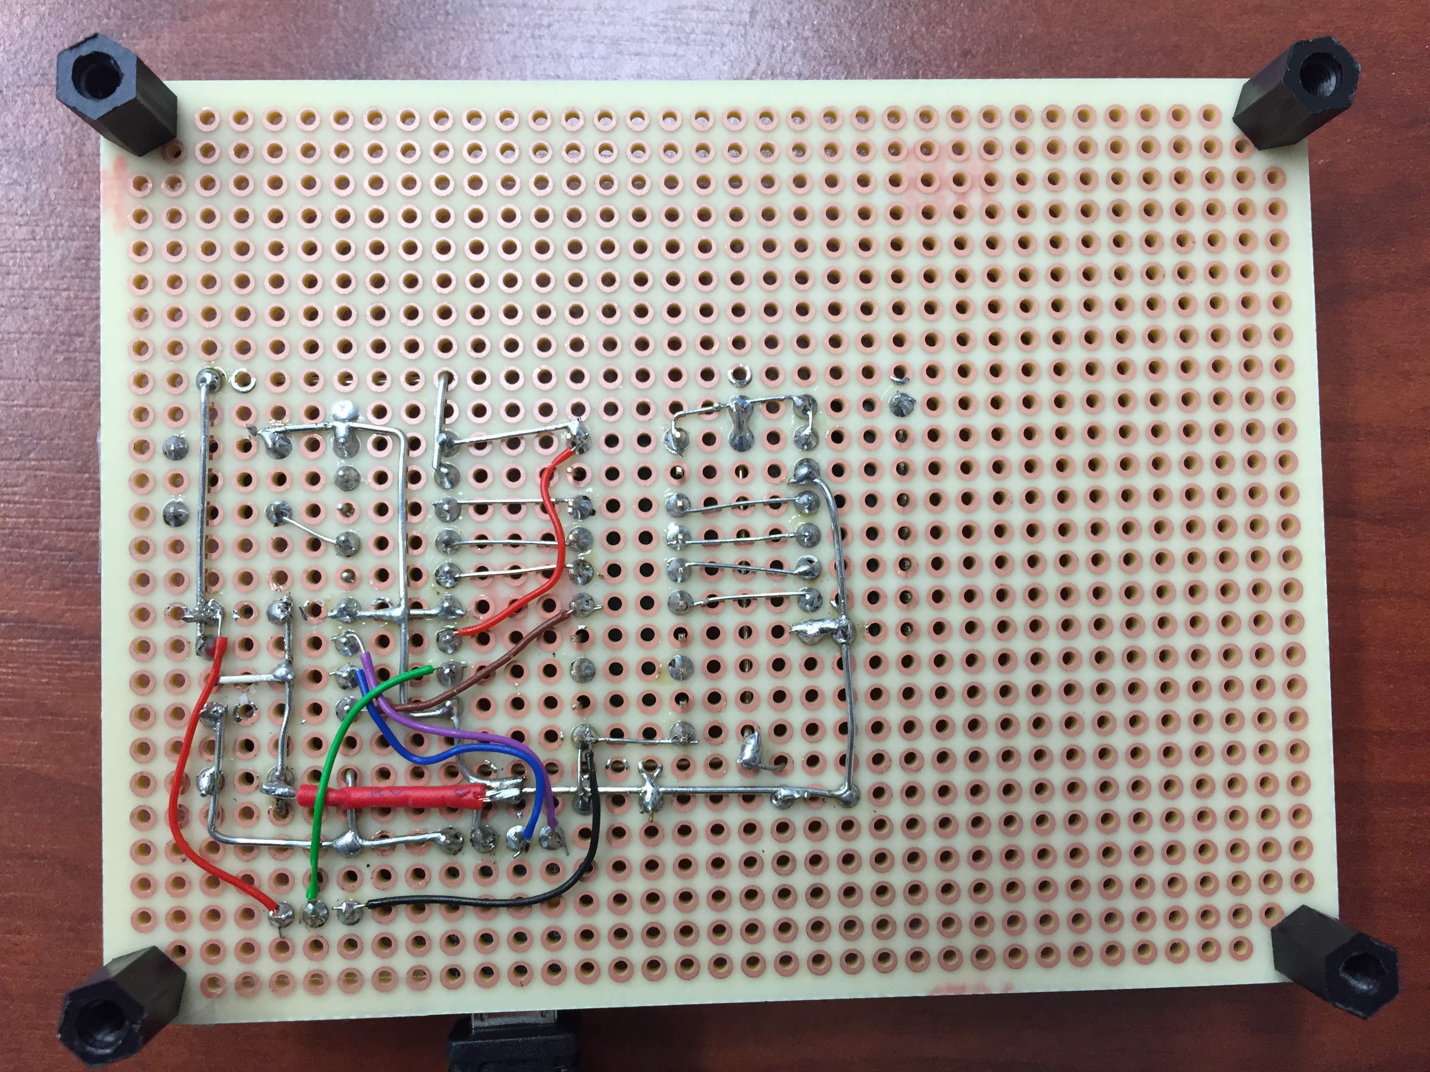

Slide 5
